Slide 1
Client Project Final Presentation Team 5-Motion
Stephanie Sykora
Stefania Polverelli
Corey West

Slide 2
Scenario:
Free Joint Motion has a new, patented product unlike any other ankle therapy available.
However, this startup is currently facing the following issues:
Lack of funding
Lack of knowledge as well as disinformation
Certifications and training needed
Market research
Notes:
As we have learned from our client as well as through our research, Free joint motion’s patent pending product is unlike any other ankle rehabilitation device on the market. While there are many options for this type of injury, none of them are as advanced as Free Joint Motion’s. The six axes allow the foot to have natural movement and allows the ankle to strengthen in a safer, more effective way.
However, free joint motion is a startup company and has some factors to overcome when entering the US Market. They are facing a lack of funding which is necessary for research and development, they also need to gain insight on what types of certification and training will be necessary in the US. In addition to that, we must research the market in order to find the size of the market, mode of entry and other necessary market data.

Slide 3
CAGE Analysis
Cultural
Communication differences
Values differences
Administrative
Regulation differences
Opportunity and recognition differences
Notes:
Cultural and Administrative distances to consider:
Cultural:
•Communication in the U.S. is more direct verbally with less body language.
•Communication in Argentina is emotive, being more personal and personal space is not limited.
•Values in the U.S. are individualistic, independence and self-determination.
•Values in Argentina are friendly, hospitable, loyal and committed to family.
Administrative:
•Regulations in the market can be strict and expensive in the U.S. compared in Argentina.
•Opportunity and recognition are high in the U.S. compared in Argentina.

Slide 4
Industry Analysis
Beneficial Similarities
Labor (Among Educated professionals)
The Attitude of Government towards Industry (Welcomed)
Existence of Product Differentiations (Extremely high in the USA)
Patents, trademarks, and copyrights are very important (encourages & protects important innovations)
Problematic Differences
Absolute Cost Disadvantages (Extremely high in the USA)
Social Media & Sport affiliations (Major Driving factor in USA)
Advantages rising from Economies of Scale
Industry Intensity & industry rivalry
Marketing, Past Sales, & Earnings Performance ( Very Important)
Notes:
There are many Factors that are included in the industry analysis, some of which are economics trends, social and political factors, changes in technology and the rate of which they change at. the overall attractiveness of the industry; and other the critical determinants that can guide Free Motion to have future success
Similarities:
1. Expertise among educated professionals is a big, helpful commonality. This will be easily transferable to help move Free motion
2. The Government is very welcoming to startups and new business into the industry. In fact, they offer several potential grants and crowd funding to qualified organizations to further promote innovation
3. Product differentiation is what makes your product or service stand out to your target audience. It's how you distinguish what you sell from what your competitors do, and it increases brand loyalty, sales, and growth. Focusing on your customers is a good start to successful product differentiation.
4. Patents, trademarks, and copyrights are very important! These methods of protecting your intangibles while publicly providing notice to other businesses avoid copying or infringing on your intellectual property is highly encouraged
Differences:
1. The entry into the US market has significant cost disadvantages. It’s going to require a large amount of funding in order to properly enter and staple your product to solidify your name & Brand as a leader and number one choice for ankle rehabilitation
2. A large social media Prescence from a marketing perspective and sport affiliations is a MUST HAVE in this industry. This will only help certify
3&4. Economies of scale lead to increased profits, generating a higher return on capital investment and providing businesses with the platform to grow on a Larger business scale – With this being said, through our research we found that North America is projected to have the largest growth in the industry over the next 7 years however, this brings us to your next challenge which is the Industry Intensity & rivalry among competitors. If we able to find this information, then organization like Johnson & Johnson, Medtronic, Pfizer and Procter & Gamble
5. Marketing, Past Sales, & Earnings Performance are Very Important, as a new startup with only a patent pending prototype without any physical sellable product units, may send the wrong message to potential customers and users in the industry.

Slide 5
Recommendations
Identify Target Market
Rehabilitation centers
Major & University sports teams
Funding through grants
Ex. Foundation physical therapy research
Use of Social Media
Identify Barriers to entry
Ex. Foundation physical therapy research
Notes:
The first recommendation is to identify the target market. We believe the ideal target market would be rehabilitation centers as well as major and college sports teams. There is a huge market in these two sectors especially because ankle injuries are so common. For this presentation, we have decided to focus in on major universities as our entry point as we believe this is the easiest market to first tackle.
Within these markets there are many grants available that Free joint motion could qualify for that we have found through our research such as The Foundation for Physical Therapy Research which provides grants to companies like Free joint motion.
Depending on the target market chosen, we believe the use of social media will be our biggest help. Partnering up with a popular college or even professional sports team or even minor athletes with a large following and having them show how the product works in action will spread the word about Free Joint Motion and reach people all over the United States. Lastly, we must identify barriers to entry, specifically the requirements of the food and drug administration in order to break into the US market.

Slide 6


Why Universities?
Research and Knowledge Sharing & facilities
Labs and Workshops
Lower overall costs and overhead
Funding programs
key to innovation and growth in technology
Treasure trove of services
Notes:
Free Joint Motion will gain greater access to cutting-edge research and scientific talent at a time when corporate R&D budgets are increasingly under pressure. Universities will gain access to financial support and partners in research at a time when government funding is shrinking and t
Partnerships are an important part of a startup's market development strategy. The partnership helps to ensure that your company has a product that appeals to your target market. It also enables you to integrate your value chain to create a whole product solution.
For example, corporate giants like General Electric, Siemens, Rolls-Royce, and IBM, which have collaborated with universities for years, Still to this day - companies including Amazon, Facebook, Google, and Uber are using universities as a key part of their early-stage innovation and new ventures strategies
https://sloanreview.mit.edu/article/developing-successful-strategic-partnerships-with-universities/

Slide 7
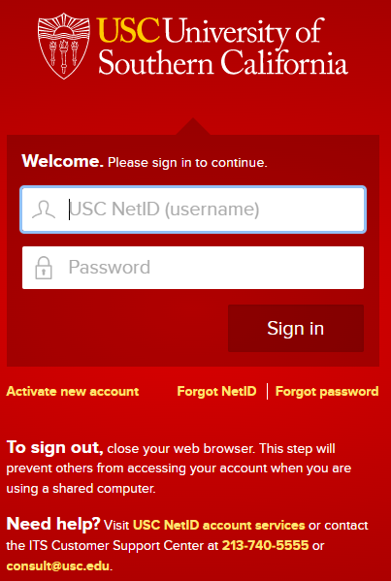


Potential Partners
Top 10 best Colleges for Sports Medicine & Rehabilitation
University of Southern California.
University of North Carolina.
Stanford University.
University of Pittsburgh.
Ohio State University.
University of South Florida.
University of California, Los Angeles.
Boston University.
https://stevens.usc.edu/usc-startups/external-resources/
Notes:
Collaborations with universities are critical drivers for Free Motions innovation. These relationships have long been a mainstay of corporate research and development (R&D) — from creating the knowledge foundations for the next generation of solutions, to serving as an extended “workbench” to solve short-term, incremental problems, to providing a flow of newly minted talent. As many corporations look to open innovation to augment their internal R&D efforts, universities have become essential partners.
University of Southern California - Has the USC Stevens Center for innovation
Alliance for SoCal Innovation
The Alliance works to bridge critical gaps. This programs focus on developing and connecting you with SoCal’s diverse innovation communities while attracting new capital by identifying, nurturing, and matching high potential startups to leading venture investors.
Biocom
Biocom works to drive public policy, build a network of industry leaders, create access to capital, introduce cutting-edge workforce development and STEM education programs, and create value-driven purchasing programs. They also host events and networking opportunities. That Free joint motion can absolutely take advantage of to get there name and product out the market
Connect with SDVG
Formed through a merger of Connect and the San Diego Venture Group, they serve entrepreneurs and startups from early stage throughout their growth journey. Connect with SDVG offers a suite of curated programs and events aimed to help companies grow, gain access to capital, and scale.
Cal State LA BioSpace
Provides emerging entrepreneurs with facilities, resources, training, and knowledge to launch startup ventures and spur regional economic development.

Slide 8
Funding
Grants
Foundation for Physical Therapy Research
Foundation for Physical Medicine Research
Attend conferences such as ACRM
Access to new info
Network
https://foundation4pt.org/grants/
https://conference.acrm.org/2022-conference/register/
Notes:
As previously mentioned, there are options available to start-up physical medicine products such as Free joint motion. The foundation for Physical therapy research is one example of a foundation that is giving away up to $500,000 for research grants in 2022. Another is the foundation for physical medicine research who also offers a variety of research grants.
Attending conferences such as the American conference of rehabilitation medicine. These types of in-person events not only allow us access to the latest research, network with colleagues from around the world, but also have access to potential funding opportunities.

Slide 9
Barriers to Entry: FDA
Class I Product: These devices present minimal potential for harm to the user and are often simpler in design than Class II or Class III devices
Regulated by FDA but some are exempt from FDA review before marketing
Still must maintain quality management system and adhere to "FDA General Controls"
Must prove the product and safe and effective
Proper branding/labeling
Registration
Notes:
FDA approval on this type of product is an obstacle that could restrict Free joint motion from entering into this industry. It is crucial that we complete our due diligence and know what to expect. After some research, we have identified Free Joint Motion as a Class I product. According toe FDA, Class I products present minimal potential for harm to the user and are often simpler in design and less invasive than class II or III devices. Class I devices are typically the fastest and easiest to bring to the market and are sometimes exempt from some requirements such as Premarket approval. Regardless of that, Class I devices still must adhere to the FDA General controls. The FDA has general controls for medical devices that ensures their safety and effectiveness. Free joint motion must ensure that the product is ready to be marketed properly and is safe and effective.
https://www.fda.gov/medical-devices/regulatory-controls/general-controls-medical-devices

Slide 10
Pricing Model
Penetration pricing
Low price to build a large customer base.
Able to stand out against competitors.
Value-Based pricing
The price is a better fit with the customer’s perspective.
The pricing brings more profit, allowing you to acquire more resources and grow.
Notes:
There are different pricing strategies to figuring out how to price your model, however, there are some examples that have the best benefits and fit with Motion's goals.
Penetration pricing is ideal in a market with numerous similar products and customers sensitive to price, a significantly lower price can make your product stand out. This strategy is generally used by new entrants into a market. You can motivate customers to switch brands and build demand for your product. As a result, that increase in sales volume may bring economies of scale and reduce your unit cost.
Value-based pricing is the perceived value to the customer is primarily based on how well it’s suited to the needs and wants of each customer. The first and top advantage of using value-based pricing is the increased value of the brand. Offering products that stand out in the market and will help better convey the uniqueness that the product. It allows for increased profits and customer loyalty.
And lastly, a good suggestion would be exchanging a competitor's older product and offering your new product at a discount can entice and keep customers interested.
https://www.bdc.ca/en/articles-tools/marketing-sales-export/marketing/pricing-5-common-strategies
https://corporatefinanceinstitute.com/resources/knowledge/strategy/penetration-pricing/
https://www.marketing91.com/value-based-pricing/

Slide 11
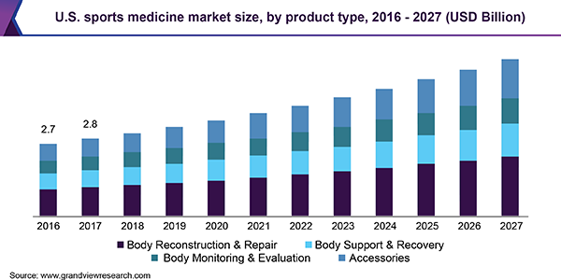
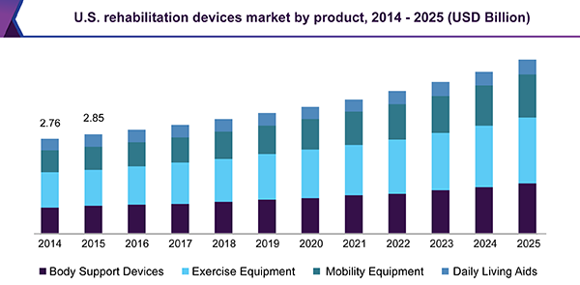
Market Size and Opportunity
The global sports medicine market size is estimated at 8.7 billion and forecasted to reached 15.2 billion by 2027 with an expected growth rate of 8.2%
The global rehabilitation equipment market size is estimated at 10.53 billion and is expected to grow at a 6.0% growth rate during the forecast period.
Notes:
Key factors that drive the market growth include rise in incidences of injuries associated with sports, increase in adoption of sports activities by people, and growth in demand for minimally invasive treatment methods. Thus, rise in incidences of sports injuries worldwide propels demand for the market growth. Also, government initiatives for the sports industry are continuously liable for expansion of the market.
Sports Medicine - Body Sport & Recovery segment
Rehabilitation – Mobility segment
https://www.grandviewresearch.com/industry-analysis/sports-medicine-industry#:~:text=The%20global%20sports%20medicine%20market%20size%20was%20estimated%20at%20USD,USD%208.7%20billion%20in%202020
https://www.businesswire.com/news/home/20220607005987/en/The-Worldwide-Sports-Medicine-Industry-is-Projected-to-Reach-12.8-Billion-by-2030---ResearchAndMarkets.com

Slide 12
Summary
Step 1:
Grants
Step 2:
Focus on a University
Step 3:
Pricing Model
Step 4:
Enter Market

Slide 13
Appendix
https://www.fda.gov/medical-devices/regulatory-controls/general-controls-medical-devices
https://www.bdc.ca/en/articles-tools/marketing-sales-export/marketing/pricing-5-common-strategies
https://corporatefinanceinstitute.com/resources/knowledge/strategy/penetration-pricing/
https://www.marketing91.com/value-based-pricing/
https://www.grandviewresearch.com/industry-analysis/sports-medicine-industry#:~:text=The%20global%20sports%20medicine%20market%20size%20was%20estimated%20at%20USD,USD%208.7%20billion%20in%202020.
https://www.businesswire.com/news/home/20220607005987/en/The-Worldwide-Sports-Medicine-Industry-is-Projected-to-Reach-12.8-Billion-by-2030---ResearchAndMarkets.com

